Slide 1
K-Nearest Neighbors
Adi Bronshtein
April 11th, 2017

Slide 2
Learning Objectives
What is KNN?
Applications/Examples of KNN
Implementation in Python

Slide 3
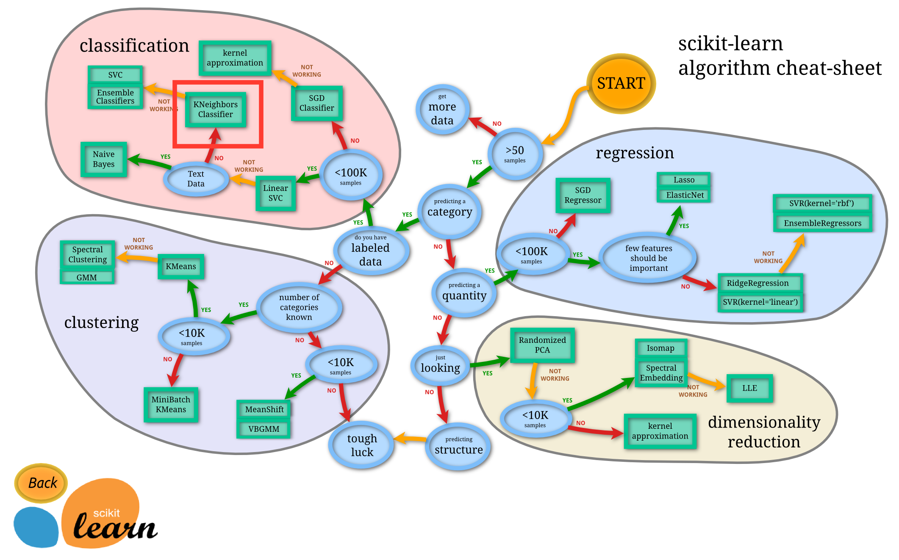
For Reference
Notes:
Just for reference

Slide 4
What is K-Nearest Neighbors Algorithm?
KNN is a non-parametric, lazy learning algorithm
Its purpose is to use a database in which the data points are separated into several classes to predict the classification of a new sample point
Can be used for classification - the output is a class membership
Or for regression - output is the value for the object
Notes:
We’ve learned about KNN in relation to classification, but it can also be used for regression.
Classification - An object is classified by a majority vote of its neighbors, with the object being assigned to the class most common among its k nearest neighbors. (Predict a class - discrete value)
Regression - This value is the average (or median) of the values of its k nearest neighbors. (Predict continuous values)

Slide 5
Non-parametric Algorithm
Non-parametric: doesn’t make any assumptions on the distribution of the data
In other words, the model structure is determined from the data
Should be one of the first choices for a classification study when there is little or no prior knowledge about the distribution data
Notes:
When you say a technique is non-parametric , it means that it does not make any assumptions on the underlying data distribution. This is pretty useful , as in the real world, most of the practical data does not obey the typical theoretical assumptions made.
should be one of the first choices for a classification study when there is little or no prior knowledge about the distribution of the data.
The term non-parametric is not meant to imply that such models completely lack parameters but that the number and nature of the parameters are flexible and not fixed in advance.

Slide 6
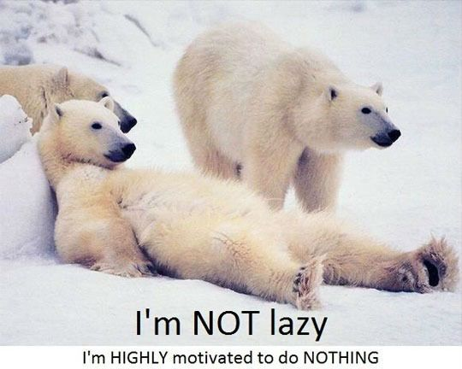
Lazy Algorithm
KNN is also a lazy algorithm
Lazy - doesn’t use the training data for generalization
Training phase is minimal
KNN keeps all of the training data
Notes:
(As opposed to an eager algorithm) Does it really mean KNN does nothing??? Not quite. What this means is that it does not use the training data points to do any generalization. In other words, there is no explicit training phase or it is very minimal. This means the training phase is pretty fast . Lack of generalization means that KNN keeps all the training data. More exactly, all the training data is needed during the testing phase. ( this is an exaggeration, but not far from truth). It also means it’s time consuming and computationally expensive, because in the testing phase it compares the entire training data.
Most of the lazy algorithms – especially KNN – makes decision based on the entire training data set (in the best case a subset of them). Also called Instance-Based Learning.

Slide 7
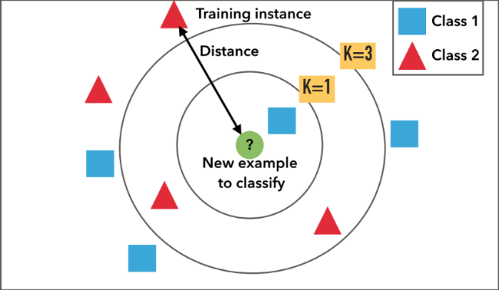
Feature Similarity
KNN Algorithm is based on feature similarity: How closely out-of-sample features resemble our training set determines how we classify a given data point
Notes:
Example of k-NN classification. The test sample (green circle) should be classified either to the first class of blue squares or to the second class of red triangles. If k = 3 (solid line circle) it is assigned to the second class because there are 2 triangles and only 1 square inside the inner circle. If k = 5 (dashed line circle) it is assigned to the first class (3 squares vs. 2 triangles inside the outer circle).
For real-valued input variables, the most popular distance measure is Euclidean distance.

Slide 8
Examples
Credit ratings - collecting financial characteristics vs. comparing people with similar financial features to a database
Should the bank give a loan to an individual? (default - yes/no)
Classifying a potential voter
More advances examples could include:
Handwriting detection
Image or even video recognition
Notes:
Credit rating details would probably be the person’s financial characteristics such as how much they earn, whether they own or rent a house, and so on, and would be used to calculate the person’s credit rating. However, the process for calculating the credit rating from the person’s details is quite expensive, so the bank would like to find some way to reduce this cost. They realise that by the very nature of a credit rating, people who have similar financial details would be given similar credit ratings. Therefore, they would like to be able to use this existing database to predict a new customer’s credit rating, without having to perform all the calculations.

Slide 9
Procedure
‣ begin
‣ looping through all known data points in training data, find the closest k points to x ‣ assign f(x) = majority classification among the k closest points
‣ end
Credit: Joseph of Iowa (AKA Joseph Nelson)

Slide 10
KNN and Bias-Variance Tradeoff
Increasing k will decrease variance and increase bias.
Decreasing k will increase variance and decrease bias.
As k increases this variability is reduced But if we increase k too much, then we no longer follow the true boundary line and we observe high bias.

Slide 11
Sklearn .neighbors.KNeighborsClassifier
class sklearn.neighbors.KNeighborsClassifier(n_neighbors=5, weights='uniform', algorithm='auto', leaf_size=30, p=2, metric='minkowski', metric_params=None, n_jobs=1, **kwargs)

Slide 12
Visualization in Python
http://nbviewer.jupyter.org/github/AdiBro/repo-for-class/blob/master/Visual%20demo%20of%20KNN%20in%20Python.ipynb

Slide 13
KNN Algorithm Pros and Cons
PROS
High accuracy (relatively)
Insensitive to outliers
No assumptions about data (think non-linear)
Simple algorithm
Versatile - useful for classification or regression
Cons
Computationally expensive
High memory requirement
Stores all (or almost all) of the training data
Prediction stage might be slow (with big N)
Sensitive to irrelevant features and the scale of the data
Notes:
Accuracy - is pretty high but not competitive in comparison to better supervised learning models
Insensitive - accuracy can be affected from noise or irrelevant features
No assumptions - useful for nonlinear data
Simple algorithm - to explain and understand.

Slide 14
Summary of Algorithm
The algorithm can be summarized as:
A positive integer k is specified, along with a new sample
We select the k entries in our database which are closest to the new sample
We find the most common classification of these entries
This is the classification we give to the new sample

Slide 15
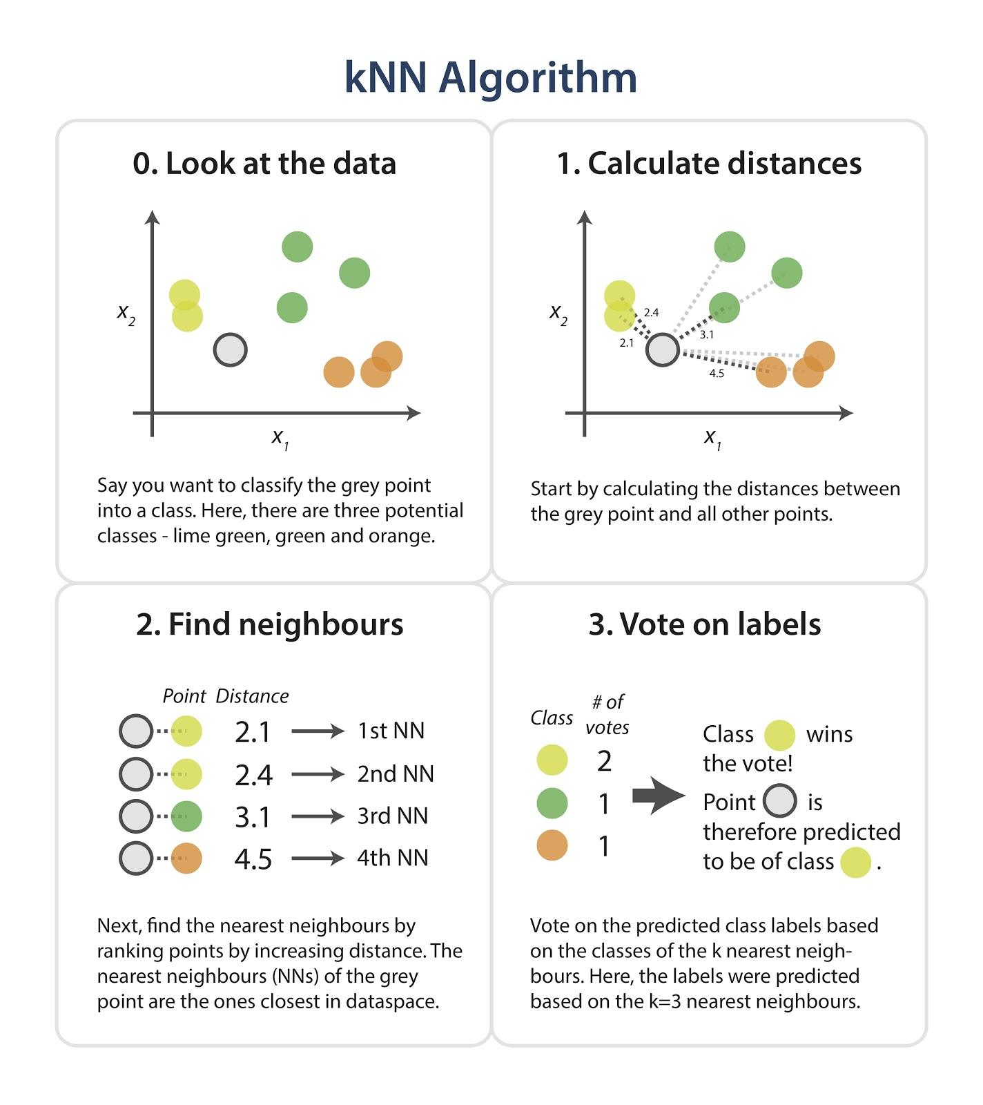
A Visual Summary of the Model
Notes:
Just a visual - I thought it sums it up pretty well!

Slide 16
Summary and Takeaways
KNN stores the entire training dataset which it uses as its representation.
KNN does not learn any model.
KNN makes predictions just-in-time by calculating the similarity between an input sample and each training instance.

